Slide 1
High Distinction Assignment
By Paul Jiang (13185172)

Slide 2
Stock Market Research
Develop an insight into breaking down the market into components
Learning about trends on a
Sector, industry and subindustry level
Company level
Developing market statistics

Slide 3
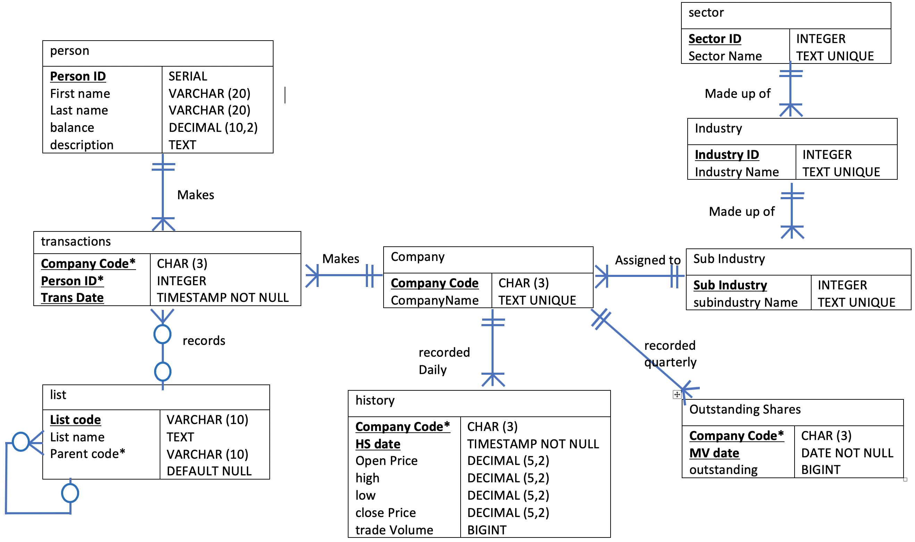
Sub-list

Slide 4
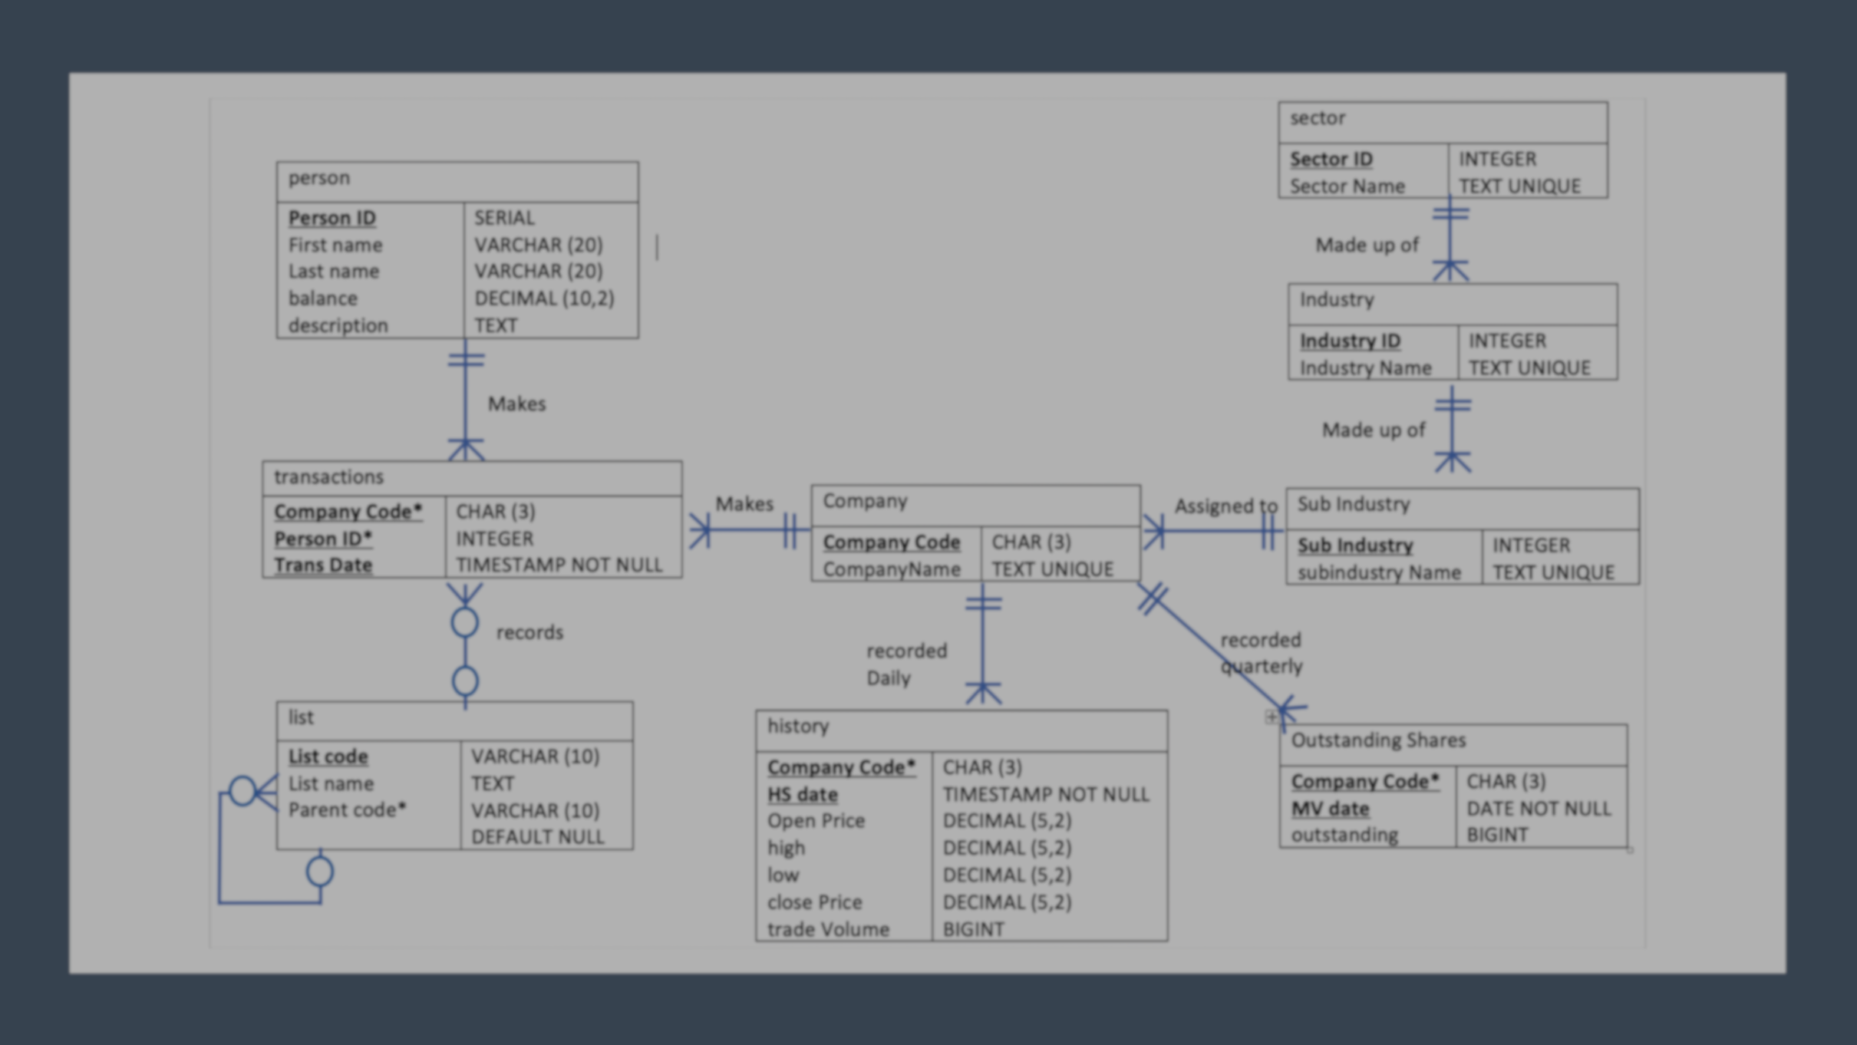
GISC Classification
GICS goal is to standard the industry definition. Definition provides us understanding of day to day company operations
This is allows for fund managers to allocate funds based on the company’s industry definition
Note: A better method is to use a recursive relationships. This is demonstrated at a later slide
sector
Sector ID Sector Name | INTEGER TEXT UNIQUE
Made up of
Industry
Industry ID Industry Name | INTEGER TEXT UNIQUE
Made up of
Financial Sector
Company
Company Code CompanyName | CHAR (3) TEXT UNIQUE
Assigned to
Sub Industry
Sub Industry subindustry Name | INTEGER TEXT UNIQUE
Banks
Insurance
Diversified Bank
Regional Bank

Slide 5
Historical information
History provides stock price and trade volume change on a daily basis
Outstanding shares (also known as the number of shares in a company) changes based on a quarterly report
If outstanding and history was in the same table
As you can see there would be a lot of redundant data
03/09/2018
Company
Company Code CompanyName | CHAR (3) TEXT UNIQUE
1 Million outstanding shares
20/09/2018
27/09/2018
recorded
Daily
recorded
quarterly
1.2 Million outstanding shares
01/10/2018
history
Company Code* HS date Open Price high low close Price trade Volume | CHAR (3) TIMESTAMP NOT NULL DECIMAL (5,2) DECIMAL (5,2) DECIMAL (5,2) DECIMAL (5,2) BIGINT
Outstanding Shares
Company Code* MV date outstanding | CHAR (3) DATE NOT NULL BIGINT

Slide 6








Transactions
Dealing with a M:M relationship between person and company
Transactions is used to break down the M:M relationship and record the transactions between a person and a company
person
Person ID First name Last name balance description | SERIAL VARCHAR (20) VARCHAR (20) DECIMAL (10,2) TEXT
Trade with
CBA
NAB
Makes
ANZ
transactions
Company Code* Person ID* Trans Date | CHAR (3) INTEGER TIMESTAMP NOT NULL
Makes
Company
Company Code CompanyName | CHAR (3) TEXT UNIQUE
J.S
AMP
D.C
Trade with
M.M

Slide 7
List
List is an optional organizational tool to help us manage business strategies
Recursive relationship is used to to create a organizational hierarchy
transactions
Company Code* Person ID* Trans Date | CHAR (3) INTEGER TIMESTAMP NOT NULL
Diversification
strategy
Industry based
strategy
records
Long
Term
Short
Term
High
EPS
High
Trade
Volume
list
List code List name Parent code* | VARCHAR (10) TEXT VARCHAR (10) DEFAULT NULL
Sub-list

Slide 8
A question I might ask myself
Between two industry in the same sector, which of the two has the best performance
Choosing which two industry to compare
Developing an understanding what companies make up the industry
Developing the data set for analysis
Assessing the yield based on the data

Slide 9
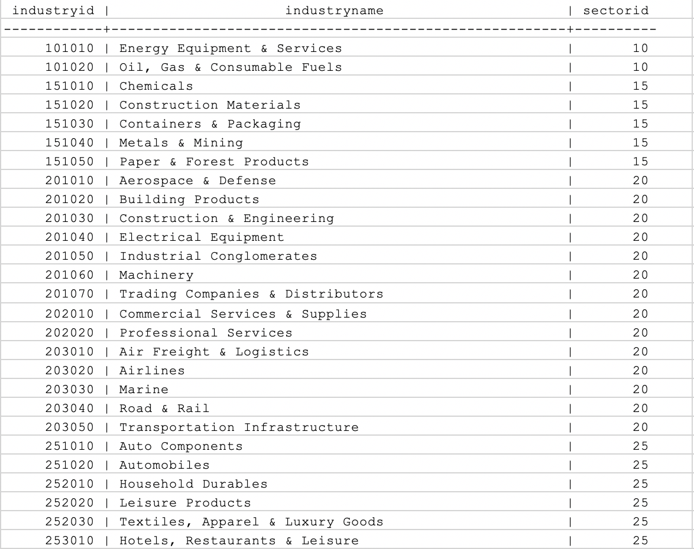
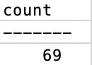
Choosing two industries
Using a simple query of a single table
Checking out the industry catalogue
SELECT * FROM industry;
Did you know there are 69 different industry classifications?
SELECT COUNT(*) FROM industry;

Slide 10
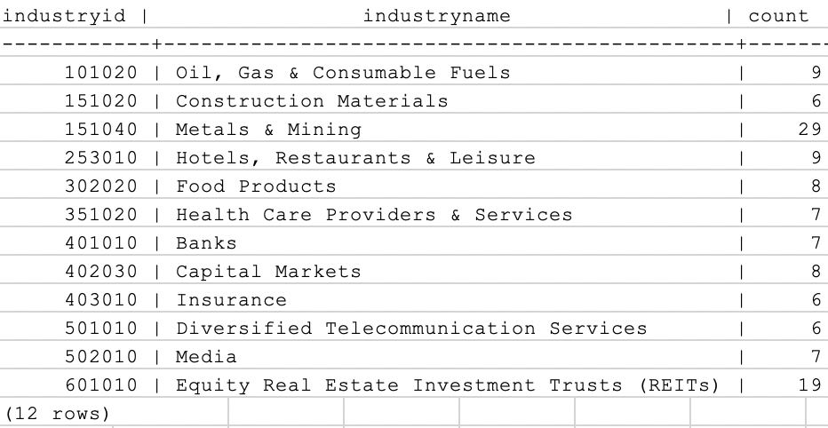
Being specific on which two industry
I want narrow down my chooses to a industry with more than 5 companies
Using a querying involving GROUP BY and HAVING
SELECT industryid, industryname, COUNT(*)
FROM industry NATURAL JOIN subindustry NATURAL JOIN company
GROUP BY industryname, industryid
HAVING COUNT(*) > 5
ORDER BY industryid;

Slide 11
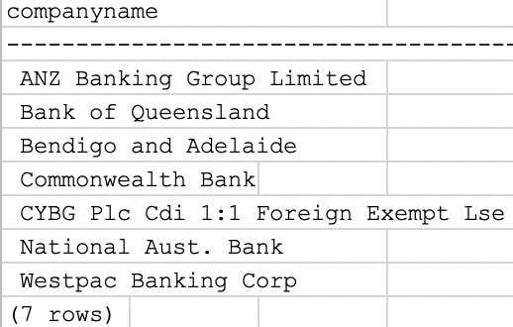
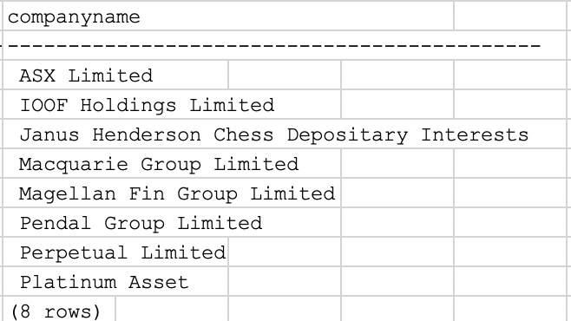
Developing understanding of company make up using NATURAL JOIN using CROSS JOIN equivalent
Make up of the bank industry
SELECT companyname
FROM industry NATURAL JOIN subindustry NATURAL JOIN company
WHERE Industryname = ‘Banks’
ORDER BY companyname;
Make up of the capital market industry
SELECT companyname
FROM company, subindustry
WHERE company.subindustryid = subindustry.subindustryid
AND subindustry.subindustryid = ANY
(SELECT subindustryid
FROM subindustry, industry
WHERE subindustry.industryid = industry.industryid
AND industryname = 'Capital Markets' );

Slide 12
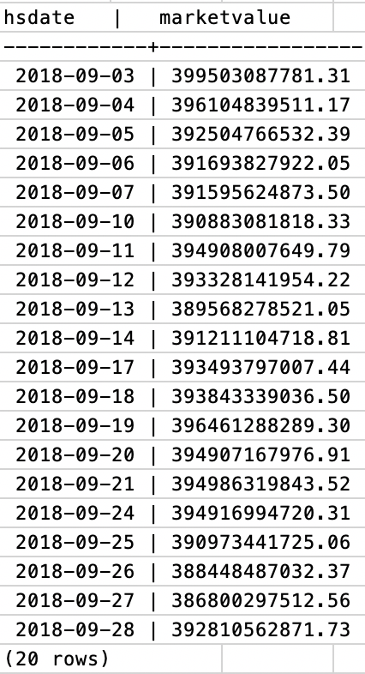
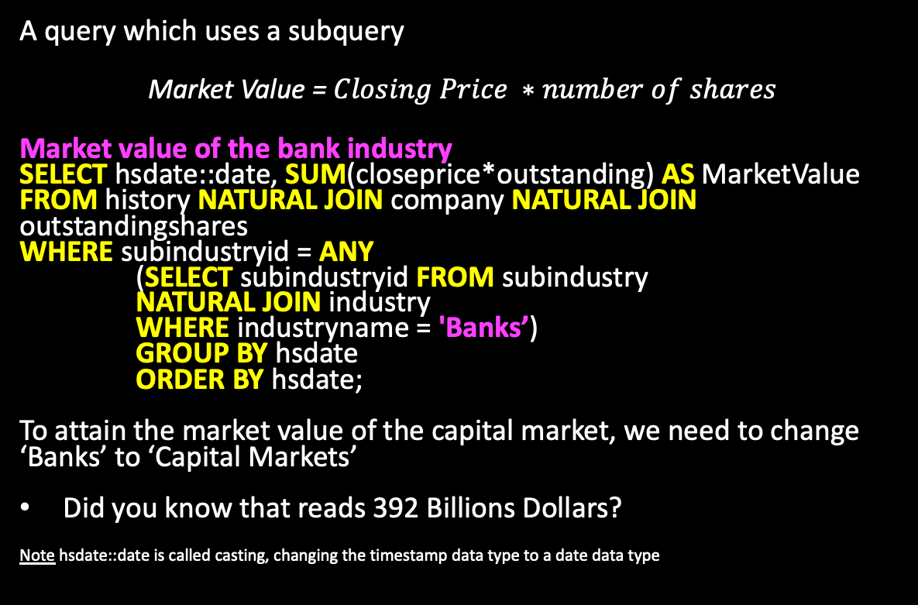
Attain market value of bank/capital market industry
A query which uses a subquery
Market Value = $Closing Price ∗number of shares$
Market value of the bank industry
SELECT hsdate::date, SUM(closeprice*outstanding) AS MarketValue
FROM history NATURAL JOIN company NATURAL JOIN outstandingshares
WHERE subindustryid = ANY
(SELECT subindustryid FROM subindustry
NATURAL JOIN industry
WHERE industryname = 'Banks’)
GROUP BY hsdate
ORDER BY hsdate;
To attain the market value of the capital market, we need to change ‘Banks’ to ‘Capital Markets’
Did you know that reads 392 Billions Dollars?
Note hsdate::date is called casting, changing the timestamp data type to a date data type

Slide 13
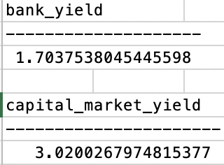
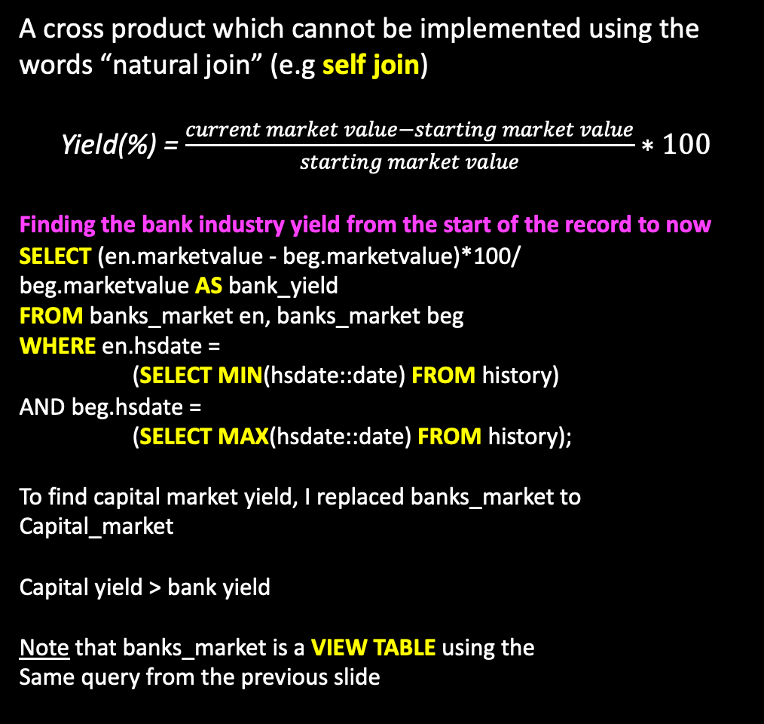
Finding the yield rate
A cross product which cannot be implemented using the words “natural join” (e.g self join)
Yield(%) = $\frac{current market value−starting market value}{starting market value}∗100$
Finding the bank industry yield from the start of the record to now
SELECT (en.marketvalue - beg.marketvalue)*100/
beg.marketvalue AS bank_yield
FROM banks_market en, banks_market beg
WHERE en.hsdate =
(SELECT MIN(hsdate::date) FROM history)
AND beg.hsdate =
(SELECT MAX(hsdate::date) FROM history);
To find capital market yield, I replaced banks_market to
Capital_market
Capital yield > bank yield
Note that banks_market is a VIEW TABLE using the
Same query from the previous slide

Slide 14
Developing insight to my database construction
Table constraints
Table action statements
For example ON DELETE CASCADE
Ease of use via the use of VIEW TABLES

Slide 15
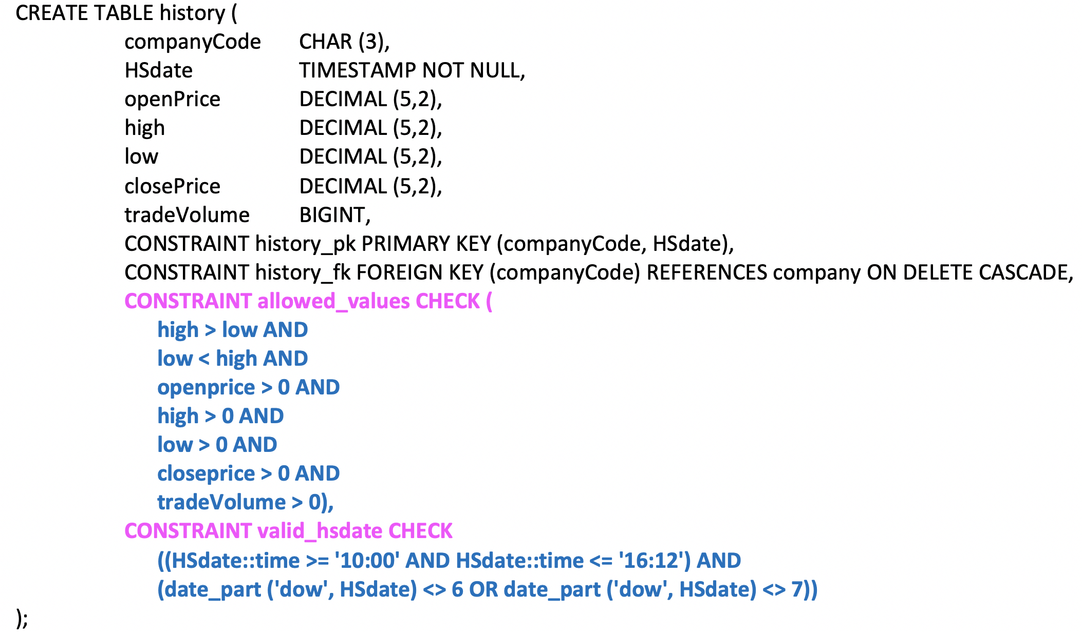
Insight into table constraints
History contains all historical stock prices and trade volumes. History records prices on a daily basis. The stock market is opened from 10 am to 4:12 pm, Monday to Friday
Pricing and volume constraints
Highest price cannot be less than the lowest price
Buy stock means your paying for it
If prices were negative at a retailer then I will buy everything in stock and get paid $1M :D
Timestamp constraint is made up of two components, the date and the time
To manage the time, the timestamp must be converted to hours
Double colon (“::”) followed by another data type converts the data type from one to another
To manage the business days, Date _ part function is used
‘DOW’ (day of the week) converts the date onto a scale 1 - 7
Monday to Friday is represented as 1 – 5
Saturday = 6 and Sunday = 7

Slide 16
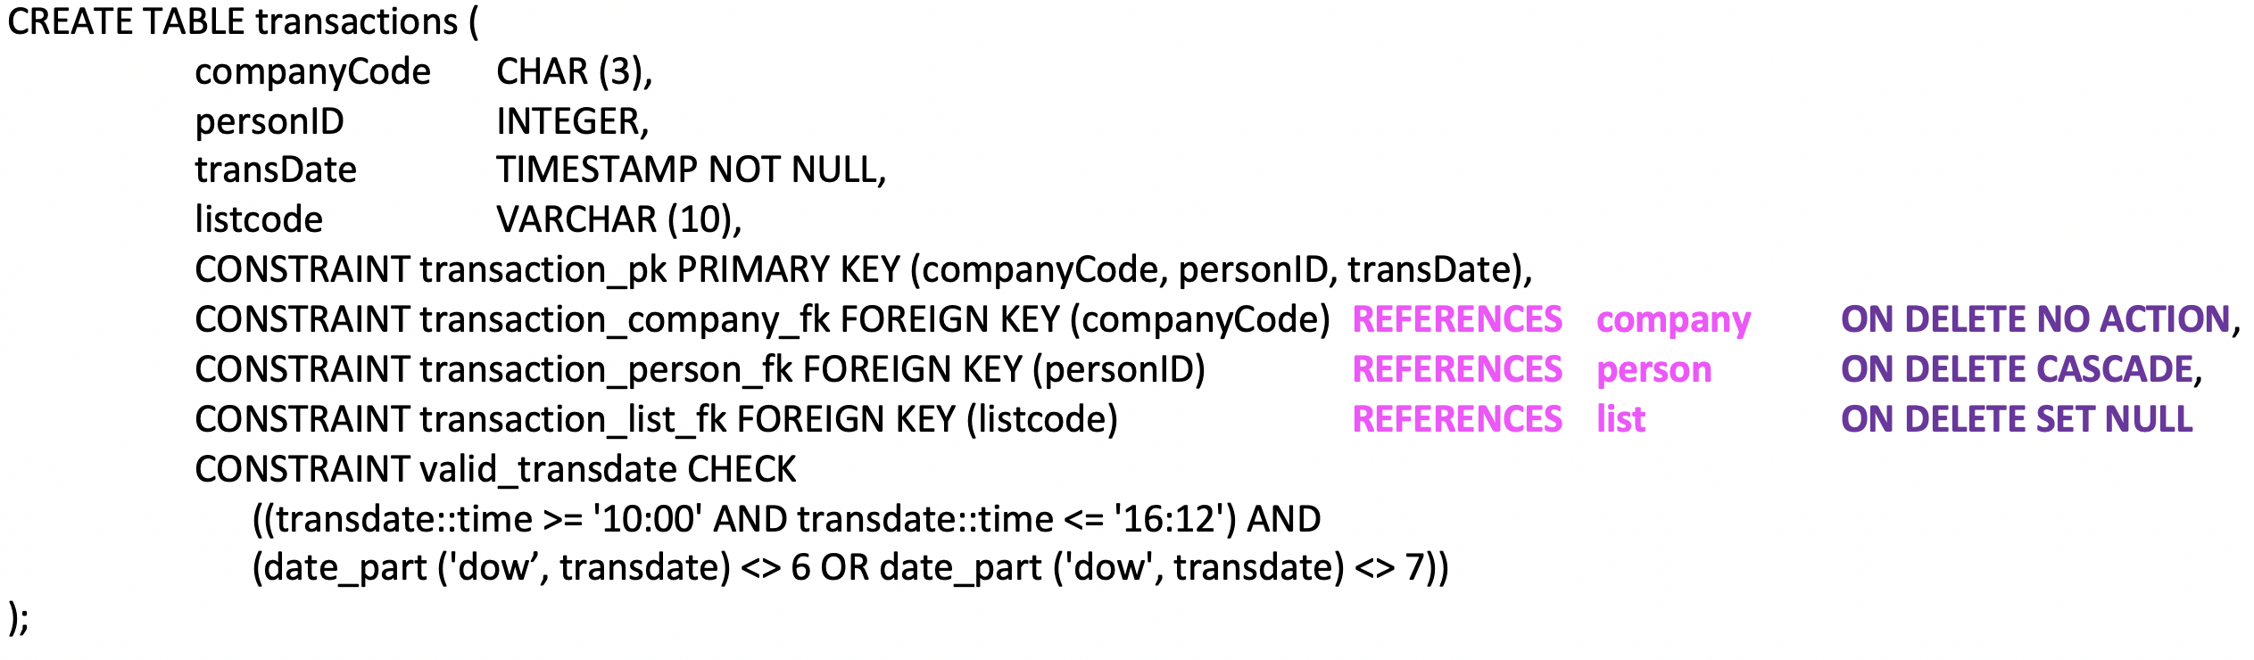
Insight into table action statements
Transaction is a weak entity that records the trades between a person and a company
My concern involve people within my group, if a person leaves, then person’s transaction needs to be deleted
List is an organizational tool and optional. If a list was to be delete, all references is set to null and the record is to remain within the transaction list
If a company was to become private or has gone bankrupt, this should have no effect on the transaction

Slide 17

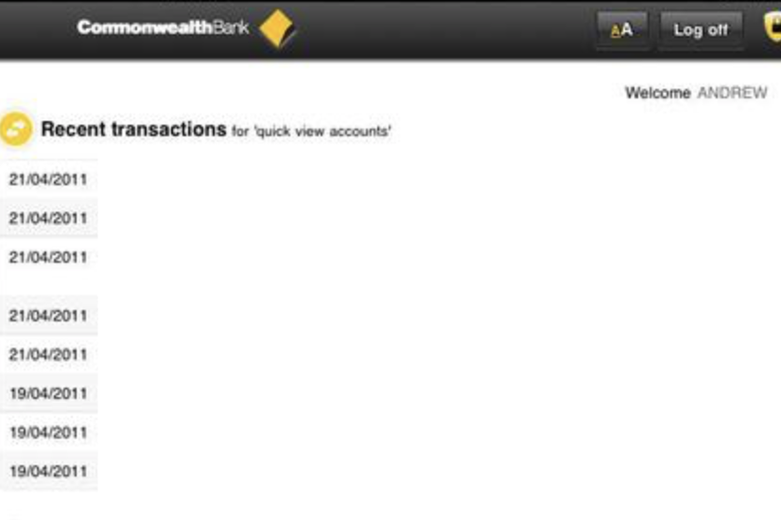


Slide 18
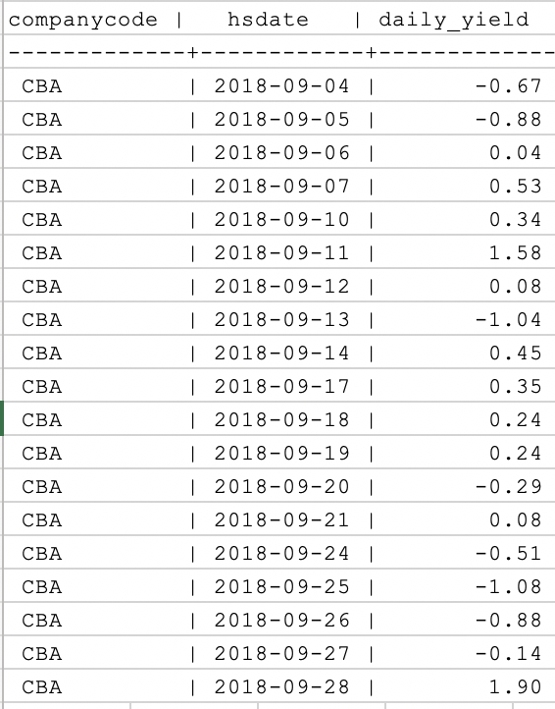
Ease of use via VIEW TABLES
Using a view table to calculate the daily return on a stock
CREATE VIEW daily_return AS
SELECT one.companycode, one.hsdate::date,
((one.closeprice - two.closeprice)/ two.closeprice*100):: DECIMAL(4,2) AS daily_yield
FROM history one, history two
WHERE one.companycode = two.companycode
AND one.hsdate::date = two.hsdate::date +
CASE WHEN DATE_PART('dow',one.hsdate) = 1 THEN
3 ELSE
1 END;
Example: Finding the daily return of CBA
SELECT * FROM daily_return WHERE companycode = ‘CBA’;

Slide 19
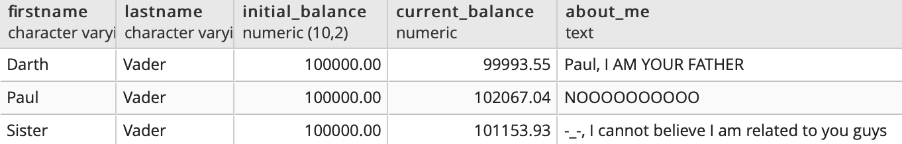
Ease of use via the use of VIEW TABLES
A future VIEW TABLE implementation
Below provides the current balance of someone’s account
This requires additional attributes added to the transaction entity
SELECT firstname, lastname, balance AS initial_balance, balance + SUM(price*amount) AS Current_Balance, Description
FROM transactions NATURAL JOIN person
GROUP BY firstname, lastname, balance, description
ORDER BY firstname;
*This result is achieved using my personal database

